Slide 1

TOEIC
AT ESIEA

Slide 2
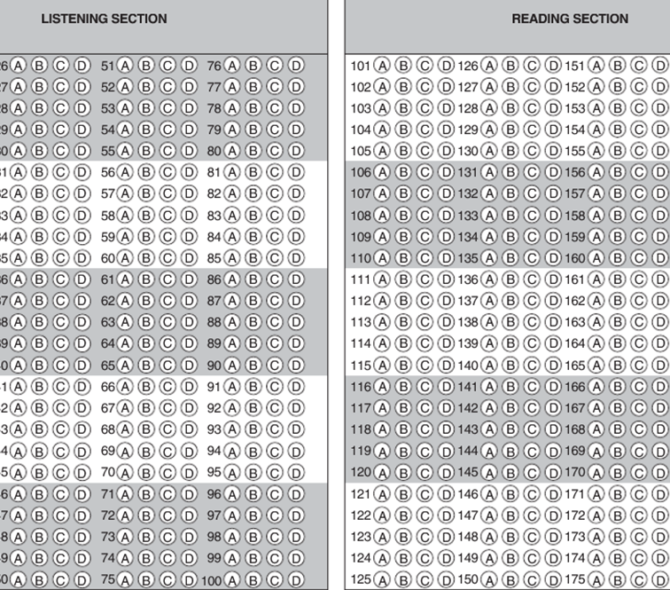
TOEIC at ESIEA
3A FISA students take the (real) TOEIC at ESIEA in November/December.
Required score to graduate: 800/990
Reading & Listening comprehension
To improve your score: Read & listen on a regular basis
ESIEA.FR

Slide 3

The TOEIC challenge
ESIEA.FR

Slide 4
TOEIC STRUCTURE
Part 1-4
Listening comprehension
100 questions
45 minutes
1
5
PICTURES
GAP-FILLS
2
6
QUESTION & RESPONSE
GAP-FILLS IN TEXTS
Part 5-7
Reading comprehension
100 questions
1 hour 15 minutes
3
7
DIALOGUES
TEXT COMPREHENSION
4
ANNOUNCEMENTS

Slide 5

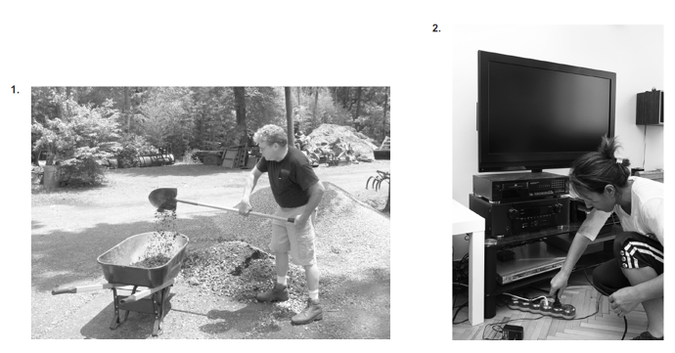
TOEIC LISTENING PART 1 (6 QUESTIONS)
ESIEA.FR

Slide 6

TOEIC LISTENING TIPS – PART 1
Watch out for
Only partially correct phrases:
‘The man is crouching behind a wheelbarrow’
Similar sounding words:
‘The man is walking in the garden’

Slide 7
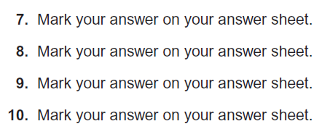
TOEIC LISTENING PART 2 (25 QUESTIONS)
ESIEA.FR

Slide 8
TOEIC LISTENING TIPS – PART 2
Make sure you hear the first word (When, What, Who, How often, How long, How late, How come, How about, Would you mind, etc.)
2) Watch out: The answers are often not predictable – for example:
Where shall we go for lunch?
- What do you think? 
- I’m eating with a client 
- How about pizza? 
3) Watch out: If a word from the question is repeated in an answer choice, it’s usually WRONG
(90% of the time). For example:
How late did you stay at work last night?
- I never work late. X
- Work was hard last night. X
- I actually got off early. 

Slide 9
TOEIC LISTENING
Part 3: Dialogues (2-3 speakers, 39 questions)
Part 4: Announcements (1 speaker, 30 questions)
There are no ‘traps’ in these sections.
The challenge: Stay concentrated.
Recommended technique: Read the questions in advance (while instructions are spoken).

Slide 10
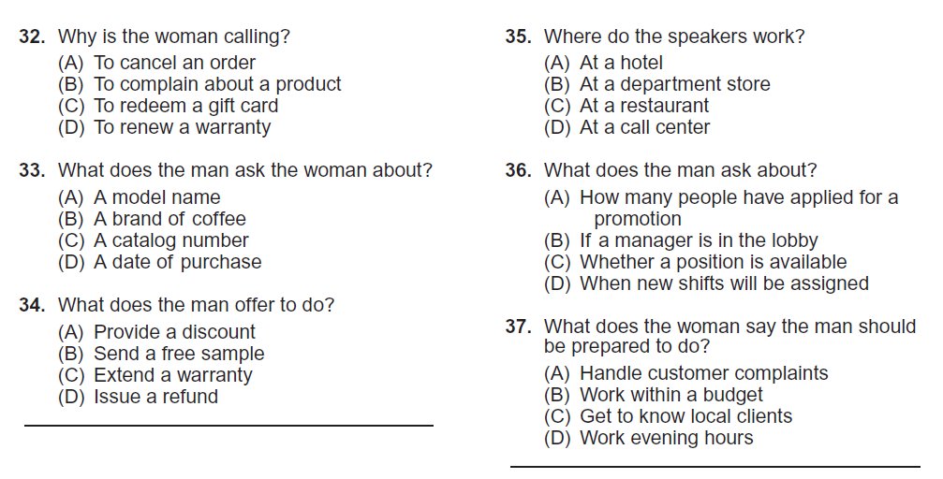
TOEIC LISTENING PART 3 (39 QUESTIONS)
ESIEA.FR

Slide 11
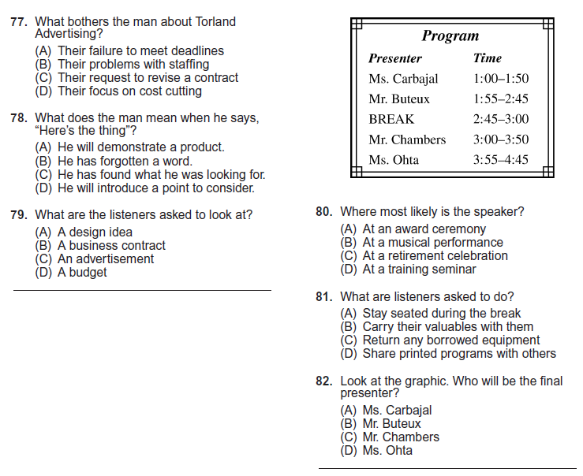
TOEIC LISTENING PART 4 (30 QUESTIONS)
ESIEA.FR

Slide 12
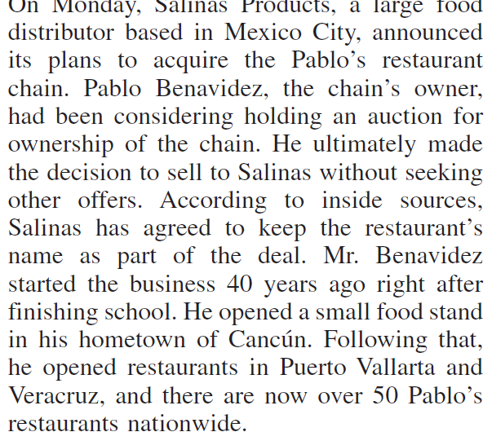
TOEIC Reading
Watch out: GOOD TIME MANAGEMENT is essential for the Reading sections.
Recommended timing:
Part 5 (Gap-fills, 30 questions) = 15 minutes (approx. 30 seconds per question)
Part 6 (Gap-fills in texts, 16 questions) = 10 minutes (approx. 30 seconds per question)
Part 7 (Text comprehension, 54 questions) = 50 minutes (approx. 1 minute per question)
ESIEA.FR

Slide 13
TOEIC READING TIPS
It is highly recommended you do the Reading sections in a different order. Start with the end of Part 7 (from the double passages to the end). Then do the beginning of Part 7, followed by Part 5 & Part 6.
In Part 7, your objective is to find the answers, NOT to read & understand everything! Read the questions slowly enough to understand them, then find the answers as quickly as possible. SKIM & SCAN.
In Part 7, look for information in logical places in the documents. For example, in an email the reason for writing is normally given at the beginning, and a request normally comes at the end.
In Part 7, look out for synonyms. For example, you could have ‘at the beginning of the year’ in the text & ‘in January’ in the correct answer choice.
Suggestion for individual practice: Do practice tests using a timer (‘chronomètre’). In Part 7, you have 1 minute per question (so for a Part 7 text with 4 questions, you have 4 minutes). In Part 5 & 6 you have 30 seconds per question. Doing this will be uncomfortable & stressful, but will help you find the right rhythm.
(For more information, tips & links, visit the TOEIC page on ESIEA’s Moodle)

Slide 14
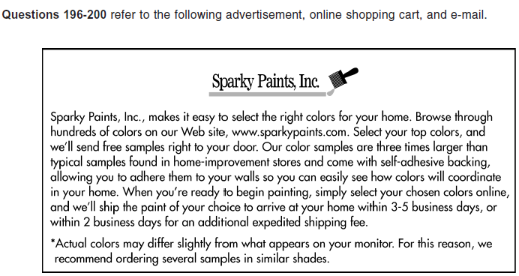
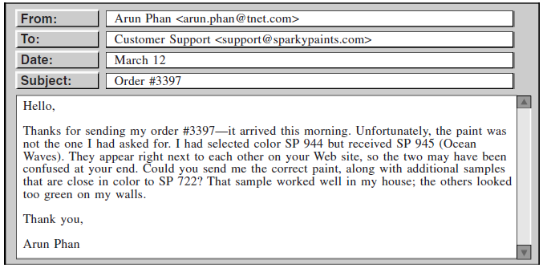
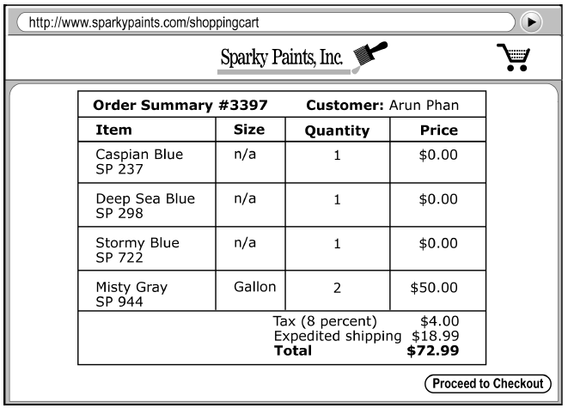
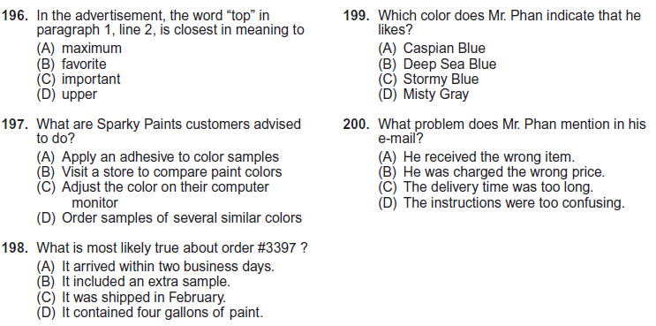
TOEIC READING PART 7 (54 QUESTIONS)

Slide 15
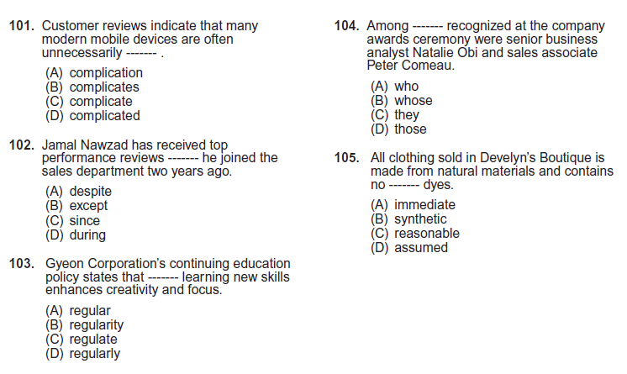
TOEIC READING PART 5 (30 QUESTIONS)

Slide 16
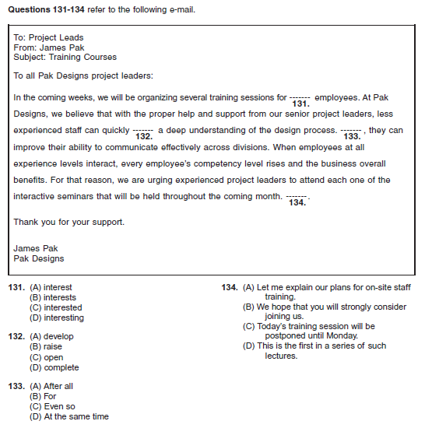
TOEIC READING PART 6 (16 QUESTIONS)

